Slide 1
SQL PROJECT ON BANK MANAGEMENT SYSTEM

Slide 2
INTRODUCTION
The Bank Management System is a relational database project designed using SQL to manage banking data efficiently. It stores and retrieves information related to Banks, Branches, Accounts, Loans, And Clients. This project demonstrates: Relational database design Use of Primary and foreign keys Data integrity Advanced SQL querying

Slide 3
PROJECT OVERVIEW
OBJECTIVE :
To design a structured banking database
To establish relationships among tables
Apply Primary key and Foreign key
To generate meaningful reports using SQL
To use advances SQL concepts such as:
Joins
Subqueries
CTEs
Window Functions

Slide 4
Tables description
BANK TABLE
purpose : Stores bank details
bank-ID
Bank_name
Bank_address ,\
BRANCH TABLE
purpose: stores branch information of banks
Banch_ID
Bank_ID
Branch_name
Branch_address

Slide 5
3. Account table
Purpose: stores customer account details
account_ID
Branch_id
Name
Account_type
4. LOAN TABLE
purpose: stores loan detail
loan_ID
Account_ID
Loan_type
Loan_amount
5.CLIENT TABLE
purpose: stores client personal detail
Client_ID
Account_ID
Name
client_address

Slide 6
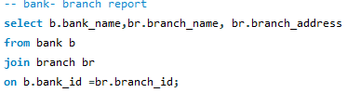
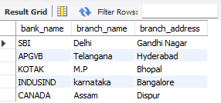
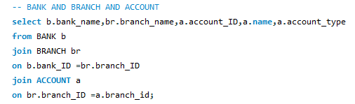
REPORTS AND QUERIES
JOIN
(bank-branch report)
(BANK –BRANCH-ACCOUNT REPORT)

Slide 7
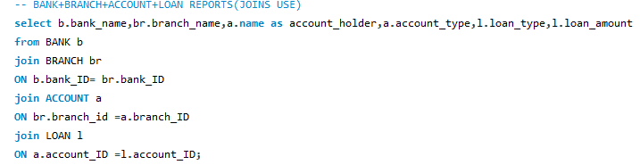
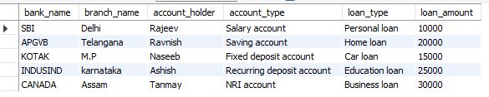
BANK+BRANCH+ACCOUNT+LOAN REPOTS

Slide 8
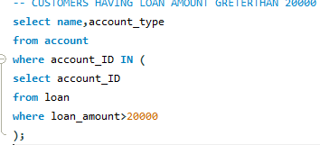

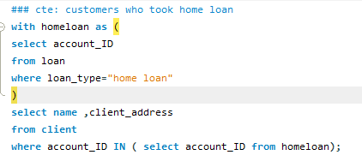

SUBQUERY:-- CUSTOMERS HAVING LOAN AMOUNT GREATERTHAN 20000
CTE: Customers who took home loan

Slide 9
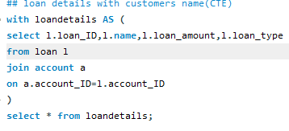
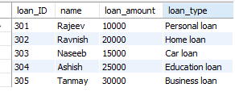
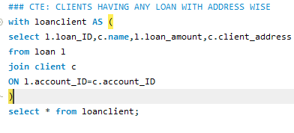
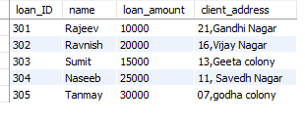
CTE: Loan details with customer Name wise
CTE: Clients Having Any Loan with Address wise

Slide 10
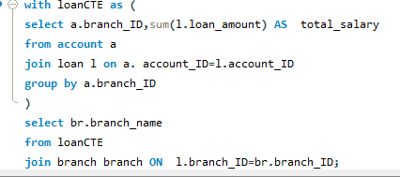
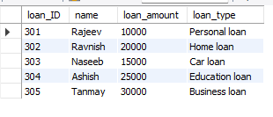
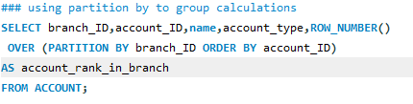
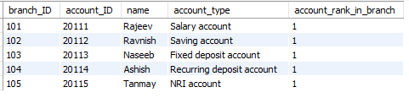
TOTAL LOAN AMOUNT PER BRANCH USING "Cte” (JOIN+GROUP BY)
### using ” partition by” to group calculations

Slide 11
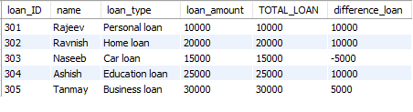
COMBINING EVERYTHING:RUNNING TOTALS COMPARISONS

Slide 12
CONCLUSION
This project demonstates:
Proper relational database design
Use of constaints
Advanced SQL queries
Real_world banking senario

Slide 13
Thank you

Slide 14
Thank you

